Slide 1
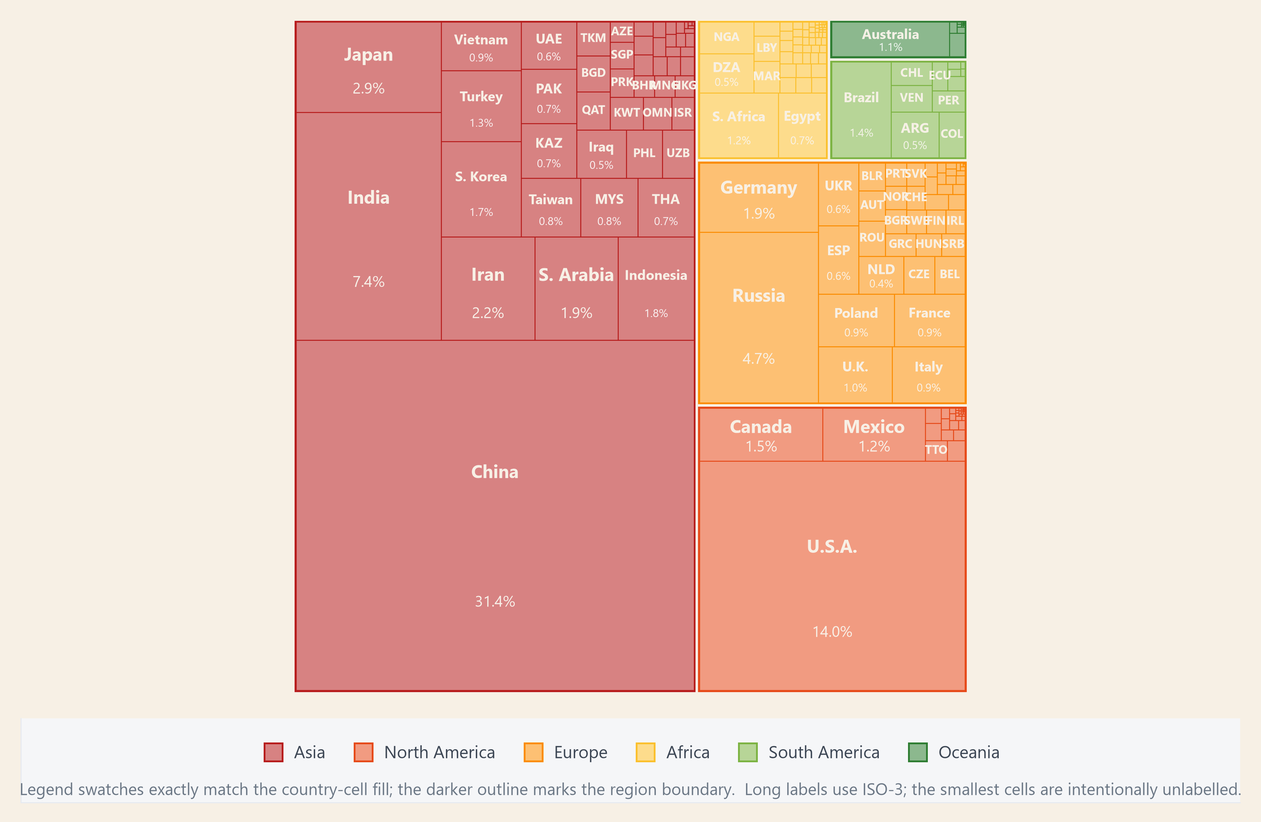
EXPLORATION OF DATASET · EMISSIONS CONCENTRATION
Asia contributes 59.8% of global CO₂ — led by China.
The treemap groups 2021 CO₂ emissions by region and country. Rectangle area represents each country’s share of the global total, making Asia’s weight—and China’s contribution—easy to compare.
KEY POINTS
• 81.2% — Top 20 countries' share of global CO₂.
• 59.8% — Asia's share of global CO₂.
• 31.4% — China's share alone.
PREPARED BY · [SHEN RUITING]
01 / 03
Notes:
This treemap is appropriate for a hierarchical part-to-whole comparison: area represents each country's share of 2021 global CO₂, while colour groups countries by region. The main pattern is strong concentration. Asia contributes 59.8% of global emissions, China alone contributes 31.4%, and the Top 20 countries account for 81.2%. The smallest cells are intentionally left unlabelled to avoid visual clutter; ISO-3 abbreviations are used where full names would not fit. The statistics were checked against the final 2021 panel. Generative AI assisted with code drafting and layout refinement; all calculations and visual claims were subsequently verified.

Slide 2
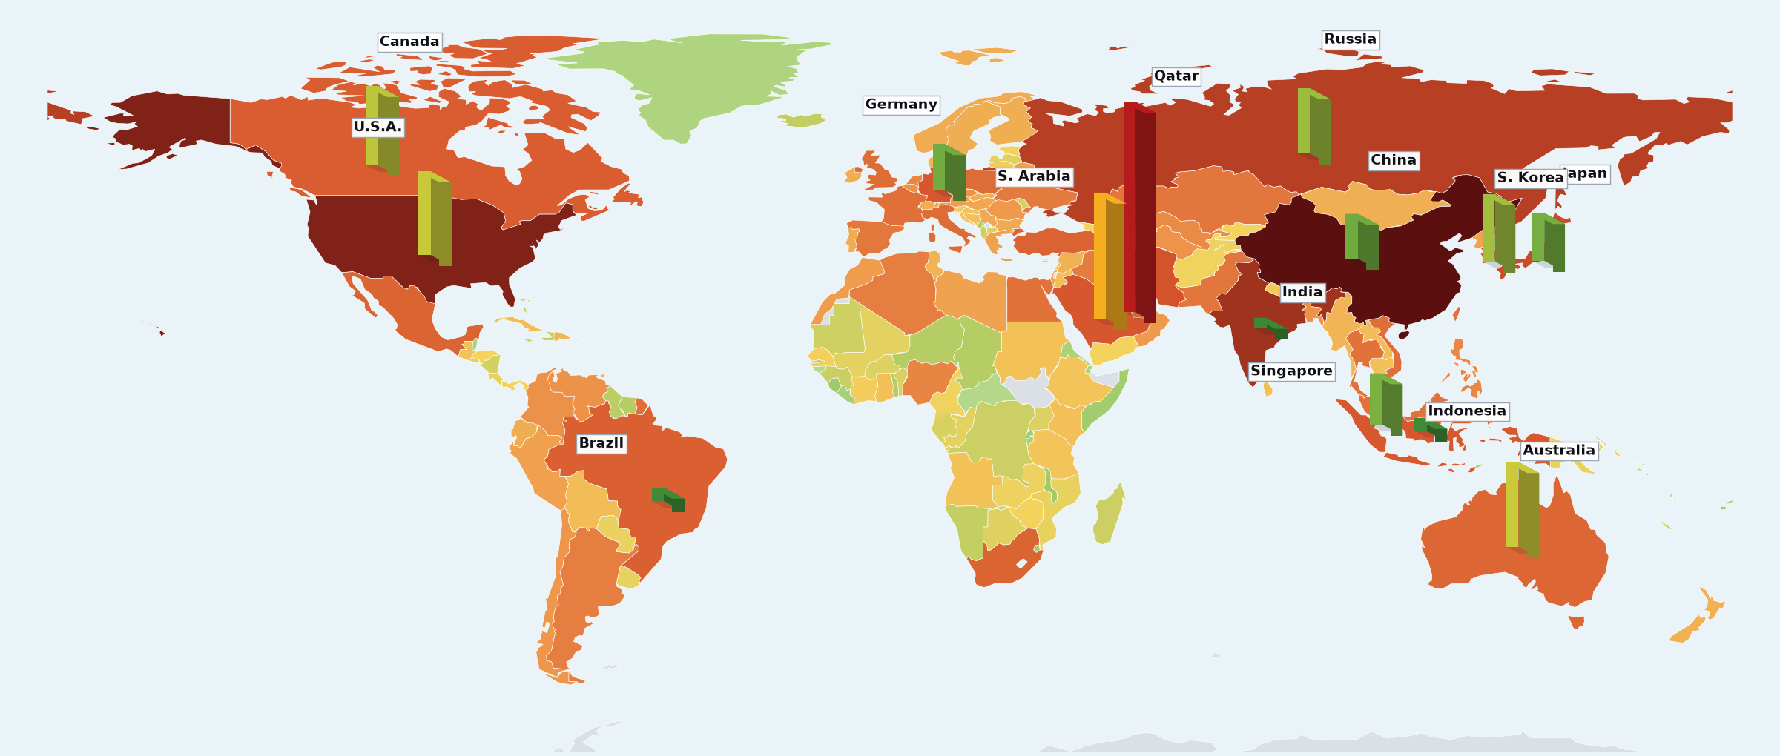
EXPLORATION OF DATASET · SCALE VS INTENSITY
Total emissions and per-capita emissions tell different stories.
KEY POINTS
Land colour shows total CO₂ on a logarithmic scale; 3-D bar height and colour show CO₂ per person. Together they contrast national scale with emissions intensity.
• Two extremes China leads total emissions, while Qatar has the highest per-capita bar. • Scale contrast large economies can dominate the total without ranking highest per person; small countries can show the reverse. • Implication total and per-capita emissions must be read together when comparing countries.
LAND · TOTAL CO₂
BAR HEIGHT + COLOUR
FILL · log₁₀(Mt)
−2
4.1
per-capita CO₂ · t/person
0
37+
PREPARED BY · [SHEN RUITING]
02 / 03
Notes:
This map deliberately combines two complementary measures. Land fill represents total CO₂ on a log₁₀ megatonne scale, while 3-D bar height and colour represent CO₂ per person in tonnes per person. The paired encodings reveal the contrast between national scale and emissions intensity: China leads total emissions, whereas Qatar has the highest per-capita value. Natural Earth 110m polygons match 169 of the 213 panel entities but still cover approximately 99.6% of global emissions. Some small islands and territories may therefore be absent from land fill; selected small-country bars are positioned separately. Generative AI assisted with implementation and layout; the underlying values were checked against the final panel.

Slide 3
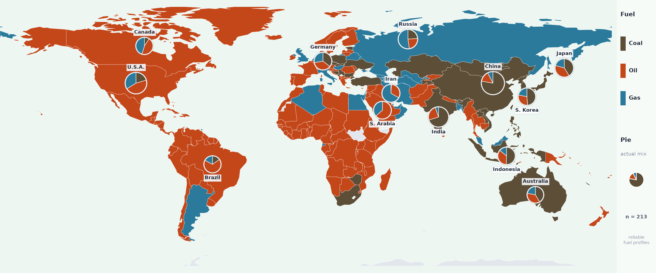
EXPLORATION OF DATASET · FUEL MIX GEOGRAPHY
National fuel mixes vary sharply across countries and regions.
Country colour shows the dominant fuel; pie charts show actual 2021 shares for major emitters. White = no data or unreliable profile.
REGIONAL PATTERN
Coal: Asia · Oil: Africa, Middle East & Americas Gas: Russia & Central Asia
WHY IT MATTERS
The same dominant fuel can mask different national mixes. Fuel shares add structure beyond scale and intensity.
PREPARED BY · [SHEN RUITING]
03 / 03
Notes:
This categorical choropleth shows each country's dominant fossil-fuel source in 2021: coal, oil or gas. Pie charts provide the actual three-fuel shares for selected major emitters, preventing the dominant-category map from hiding mixed national profiles. White areas indicate missing or unreliable fuel profiles rather than a fourth fuel category. The map uses the same Natural Earth 110m coverage limitation as the previous map, so some small territories do not have visible polygons. The figure is intended to compare spatial regimes and fuel structure, not the magnitude of total emissions. Generative AI assisted with coding and layout; fuel shares and reliability flags were checked against the final panel.

